Slide 1
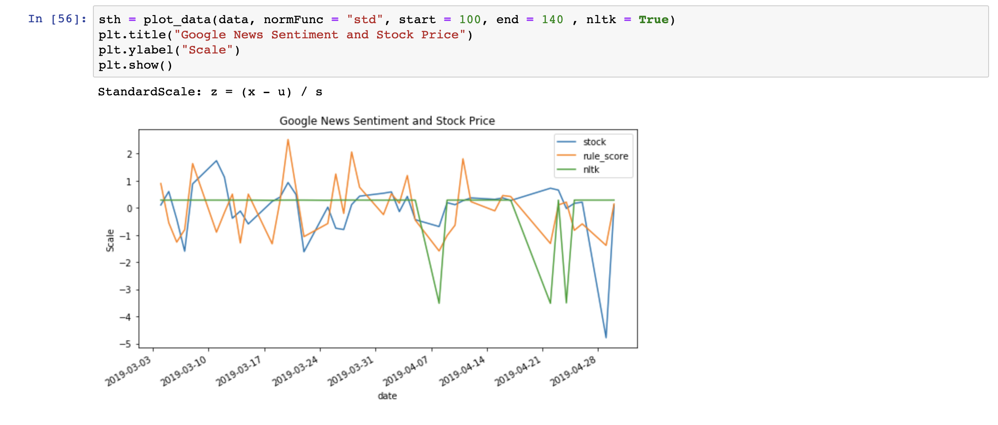

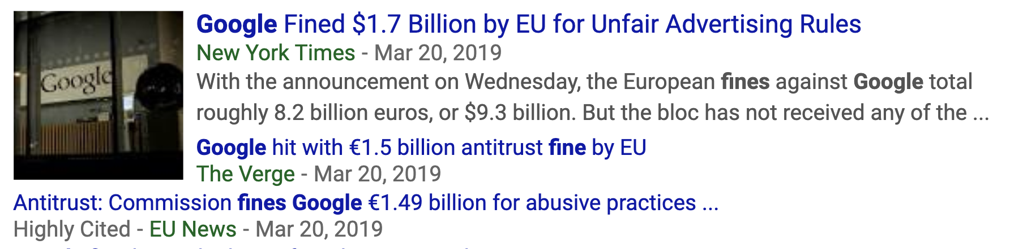

1
2
3
4
2019-03-19 Google unveils new gaming platform Stadia.
2019-03-20 The EU fines Google $1.5 billion dollars for unfair advertising rules.
2019-04-19 YouTube, a company under the same Google parent company, gets flooded by anti-Semitic comments.
2019-05-01 Google employees protest over company's handling of sexual harassment.

Slide 2
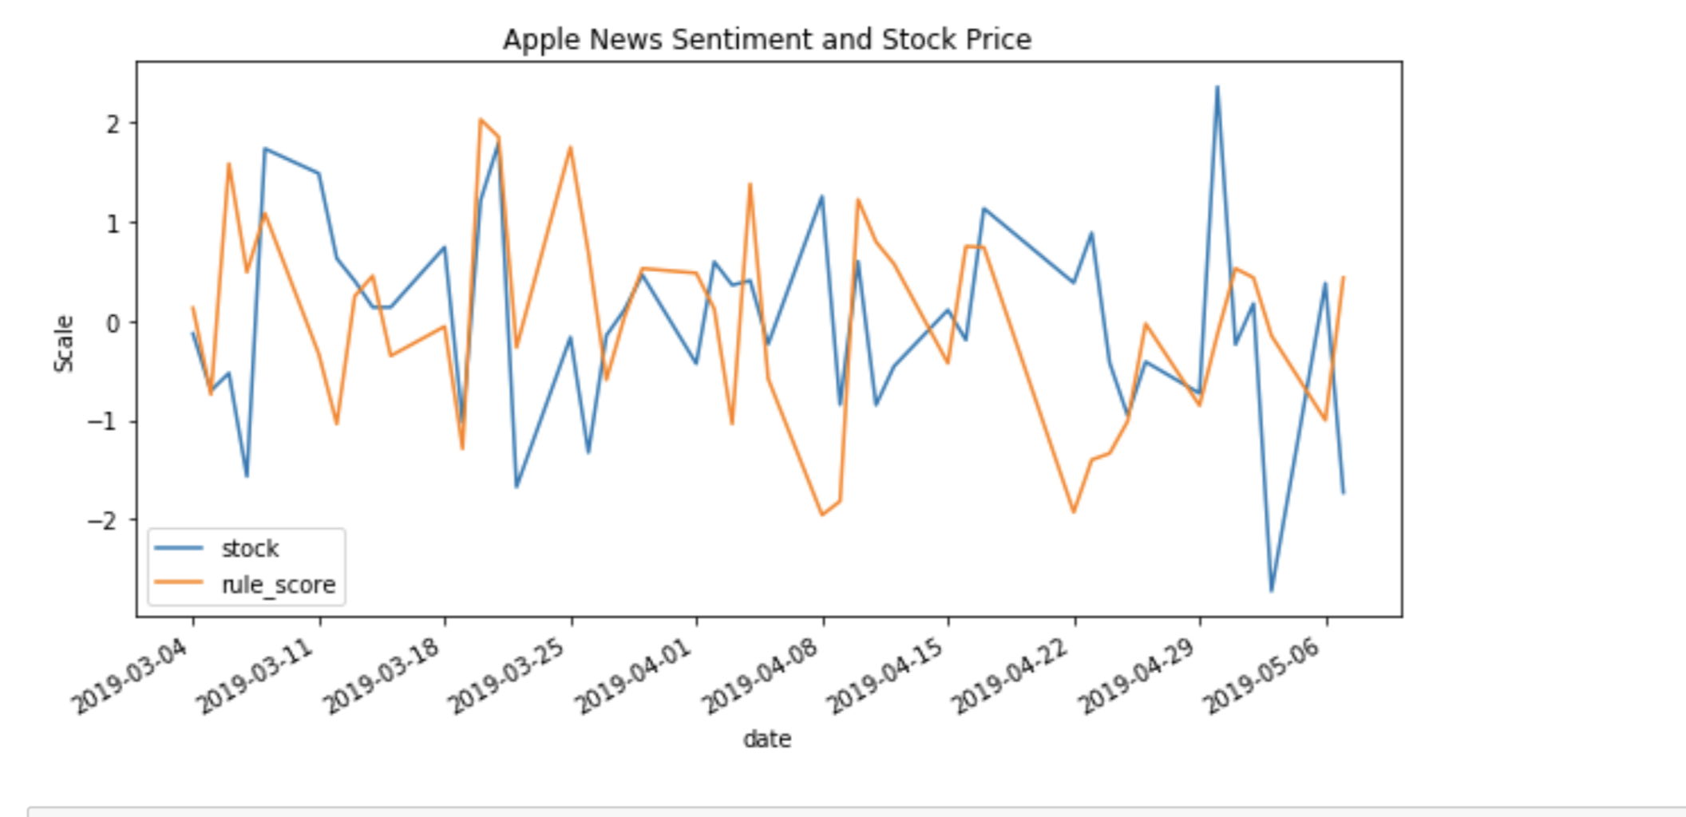
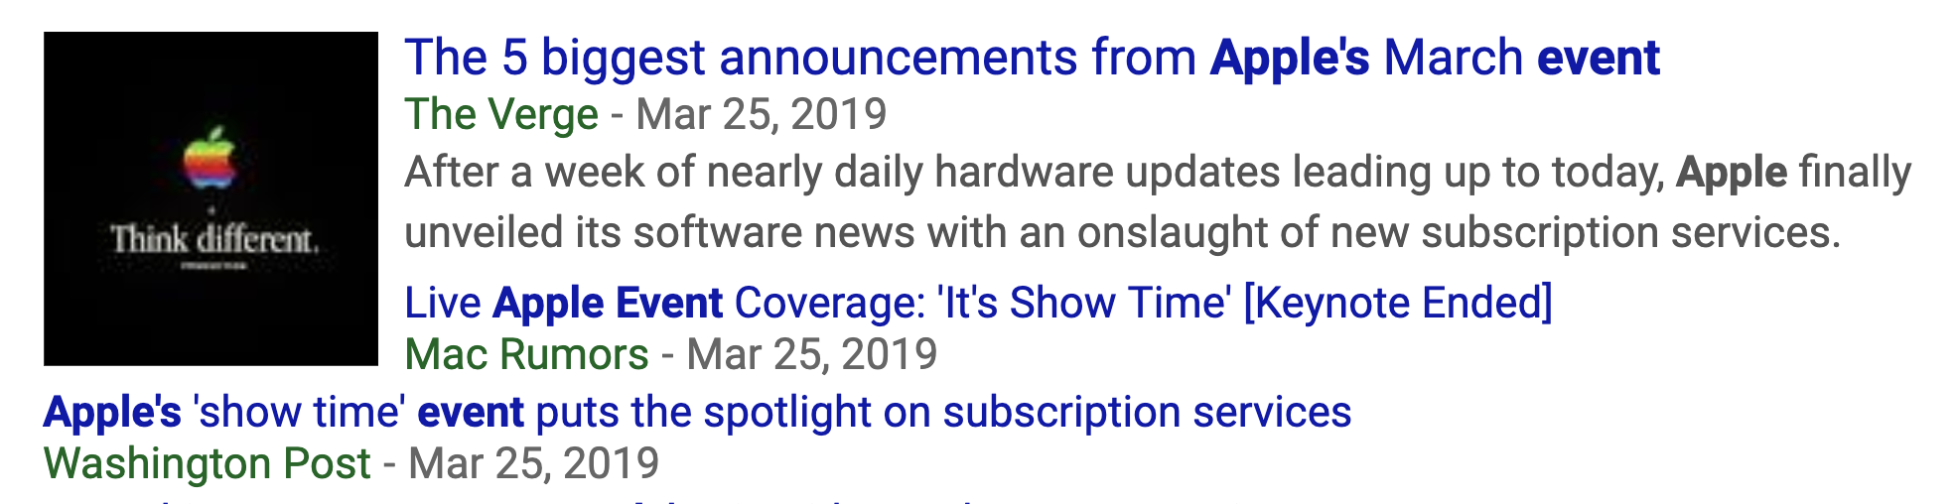
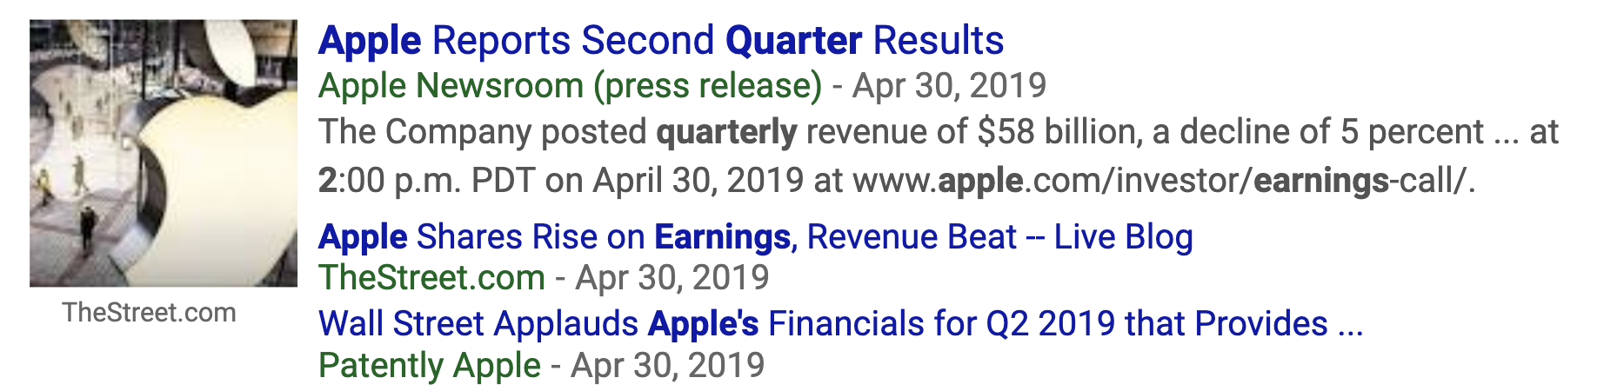
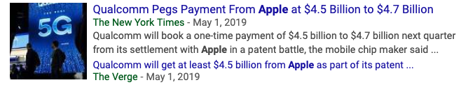
1
2
3
2019-03-18 Apple unveils new iPads.
2019-03-25 Apple holds major keynote event.
2019-04-20 Apple reports strong second quarter results, surprising Wall Street and many haters.
2019-05-01 Apple pays Qualcomm $4.5 billion over patent dispute.

Slide 3
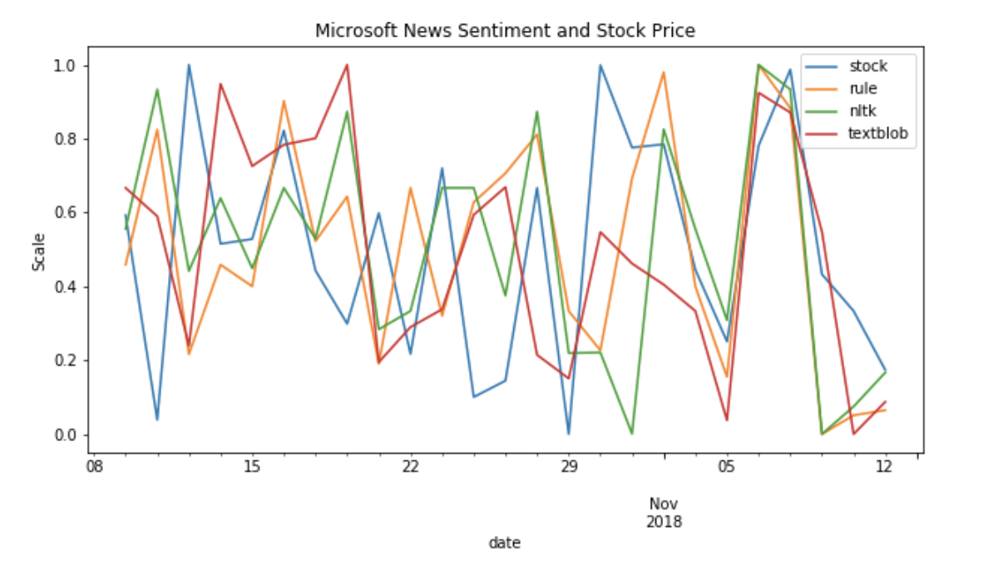
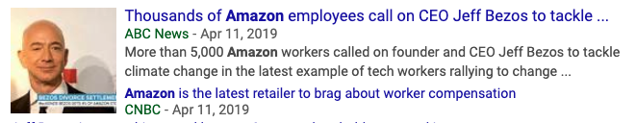


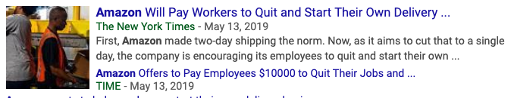
1
2
3
4
2019-04-11 Amazon employees call for company to tackle climate change.
2019-04-16 Amazon flooded by thousands of 5 star reviews.
2019-05-09 Amazon’s owner Jeff Bezos's side company announces to man a mission to the moon.
2019-05-13 Amazon offers to pay workers to quit to start their own delivery companies.

Slide 4
Text
Sentiment
Embedding Layer
Deep Network
(Conv1D)
Fully Connected Layer
Output Layer
(‘sigmoid’ for binary)

